Slide 1

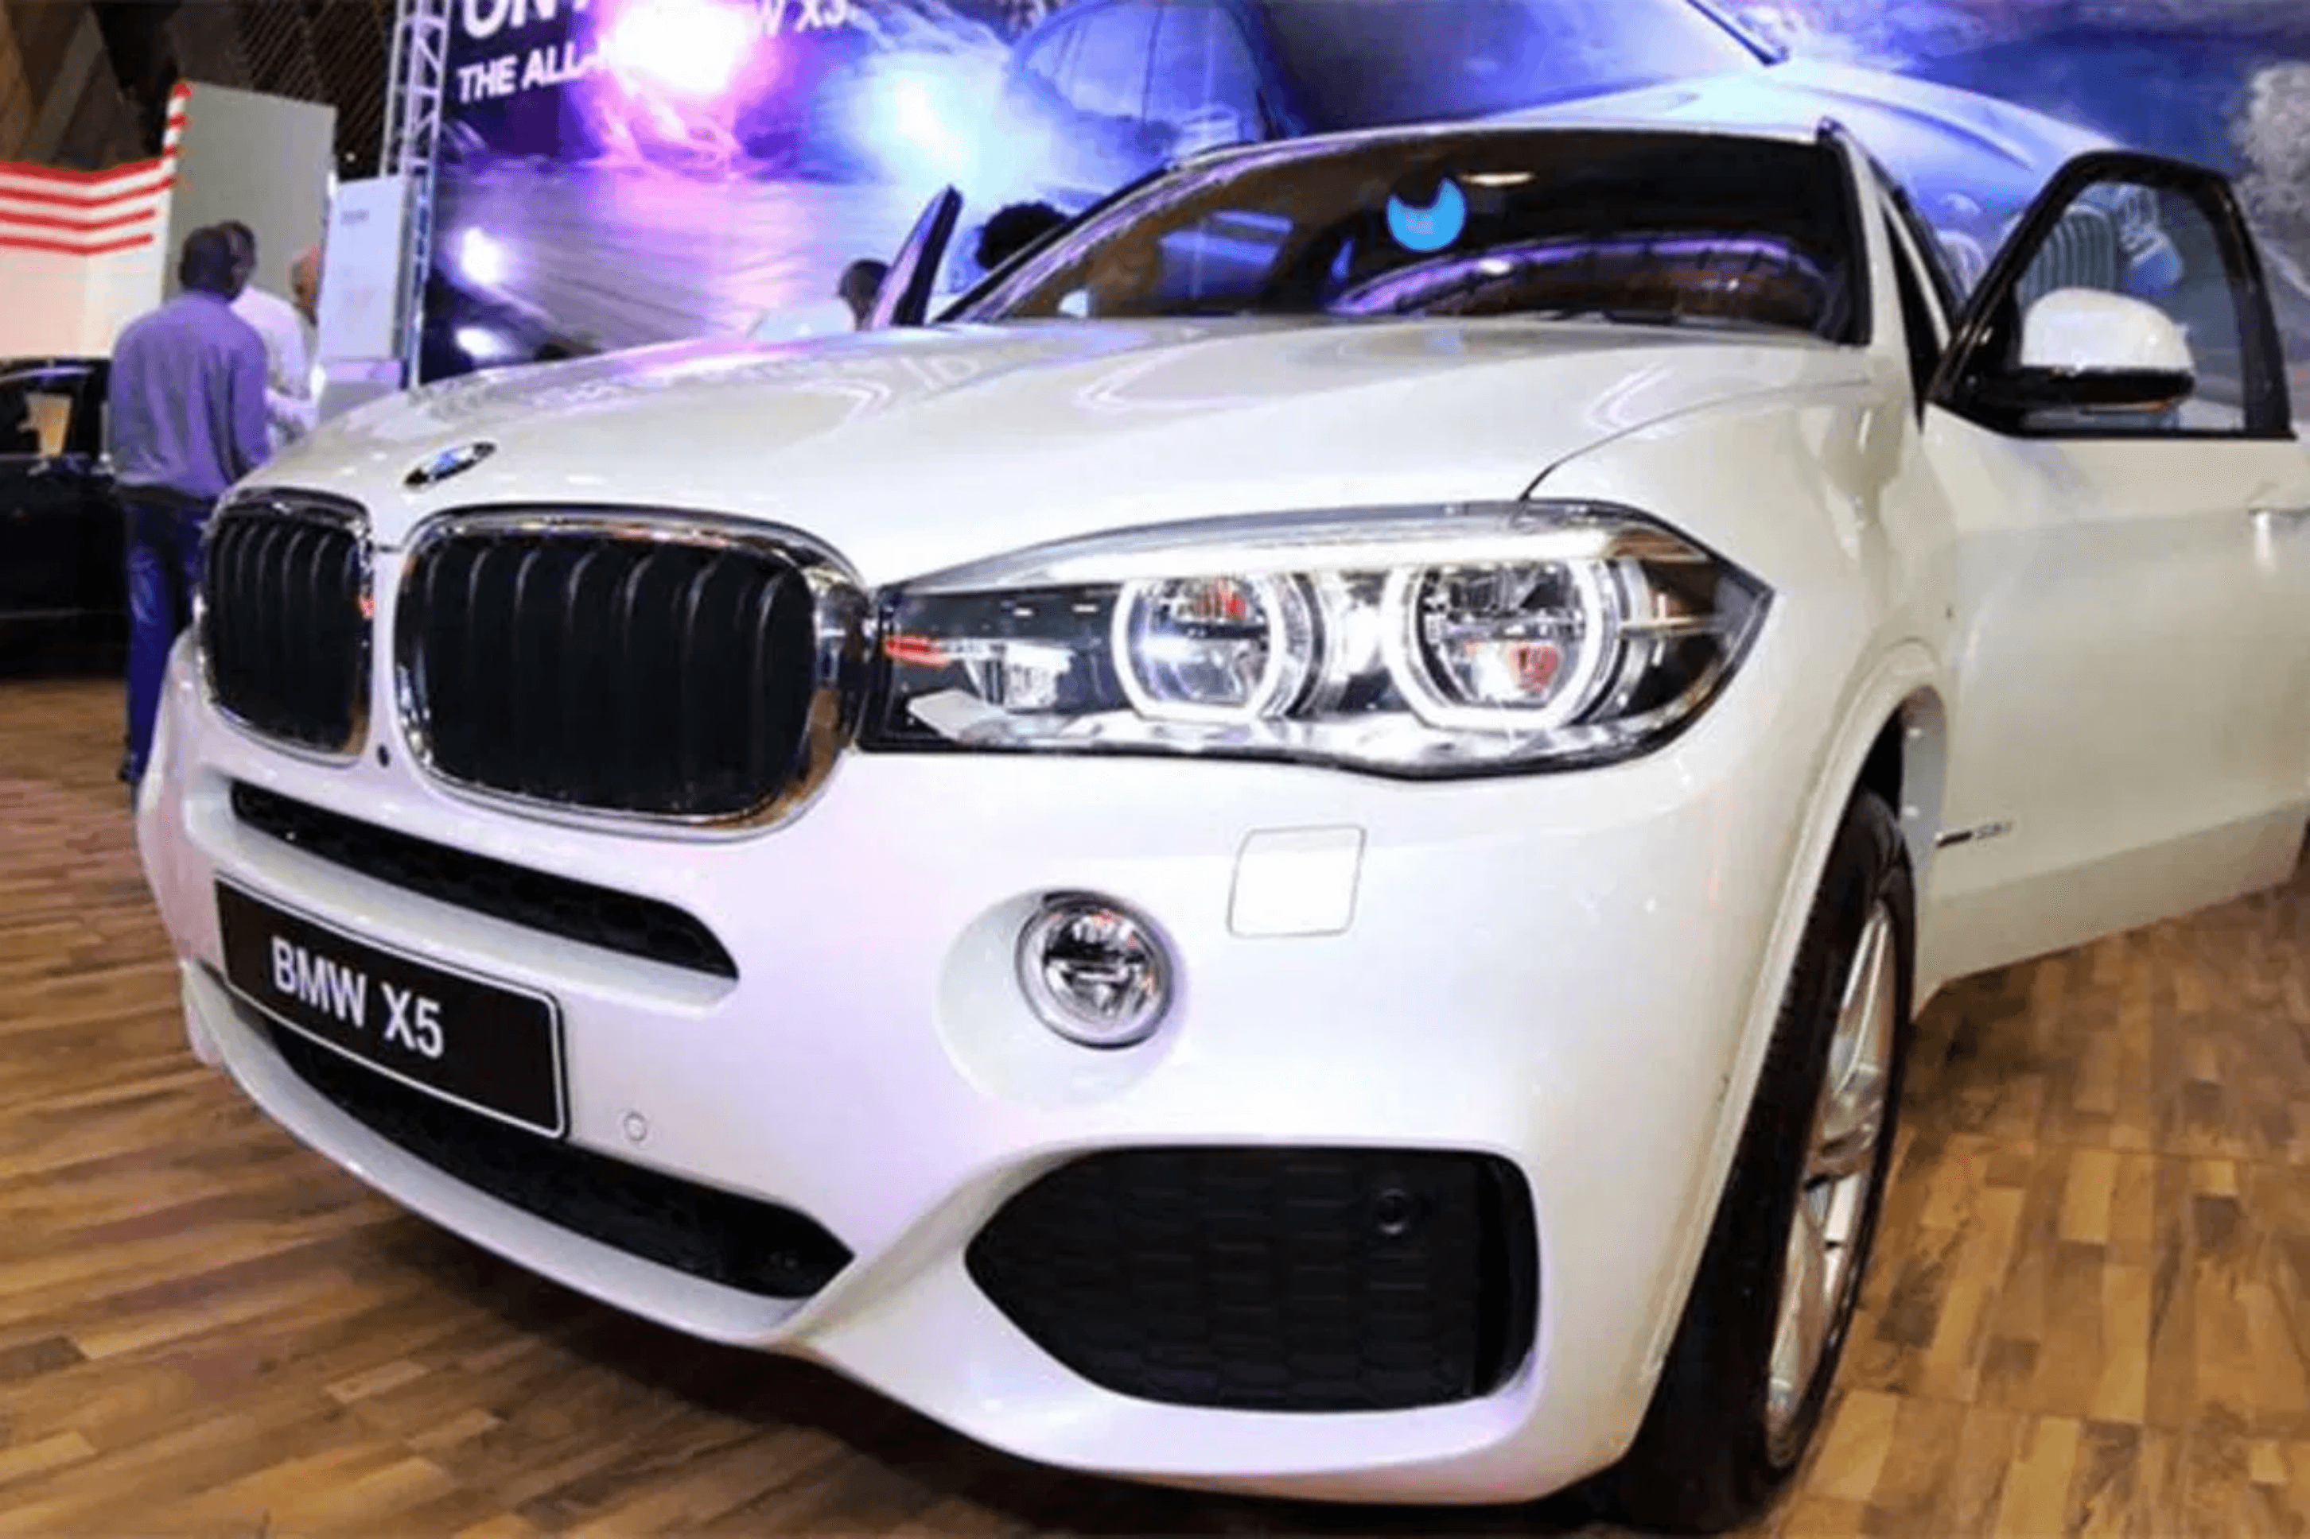
Nguvu Automotive: Capturing Kenya’s Premium Market
Strategic Expansion into Nairobi — The Hub of East African Luxury
Nguvu Automotive Leadership Team

Slide 2

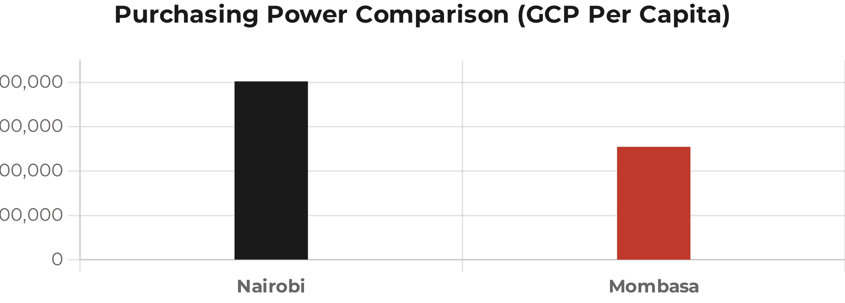
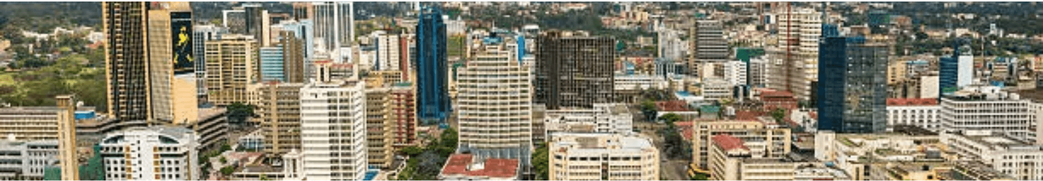
Nairobi’s Economic Dominance Makes it the Optimal Choice for Premium Expansion
27.5% GDP Contribution
Nairobi dwarfs Mombasa's 5% contribution, serving as the primary engine of Kenya's economy.
KSh 802,344 GCP Per Capita
Significantly higher purchasing power compared to Mombasa's KSh 507,337.
70% Wealth Concentration
The vast majority of households are in the highest national wealth quintile.
4,700 HNWIs
Home to nearly 7x more high-net-worth individuals than Mombasa.

Slide 3

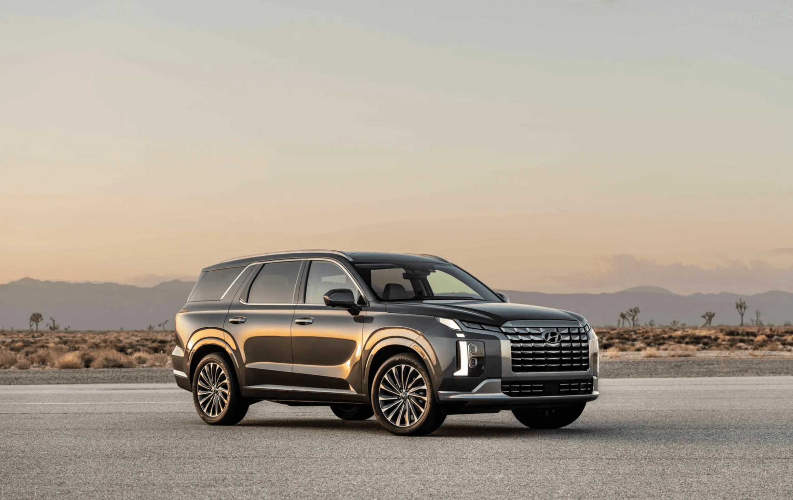
A Concentrated Base of Affluent Buyers Ready for Premium Brand Experiences
Target Demographics
Corporate executives, expatriates, and high-net-worth individuals with an affinity for status-signaling luxury.
Consumer Sentiment
High demand for premium automobiles linked with corporate culture and international lifestyle expectations.
Prime Neighborhoods
Concentrated customer base in Nairobi's most affluent districts.
Muthaiga
Kyuna
Kilimani
Lavington

Slide 4

Leveraging a Robust Automotive Ecosystem to Drive Market Share
Established Market
Support Infrastructure
Strategic Advantage
Successful operations of global brands like BMW, Mercedes-Benz, and Porsche prove the high viability of Nairobi's luxury segment.
Access to specialized service centers, high-end finance options, and a mature dealership support network reduces operational friction.
Nguvu will differentiate through superior after-sales service and exclusive brand experiences tailored to the local elite.

Slide 5

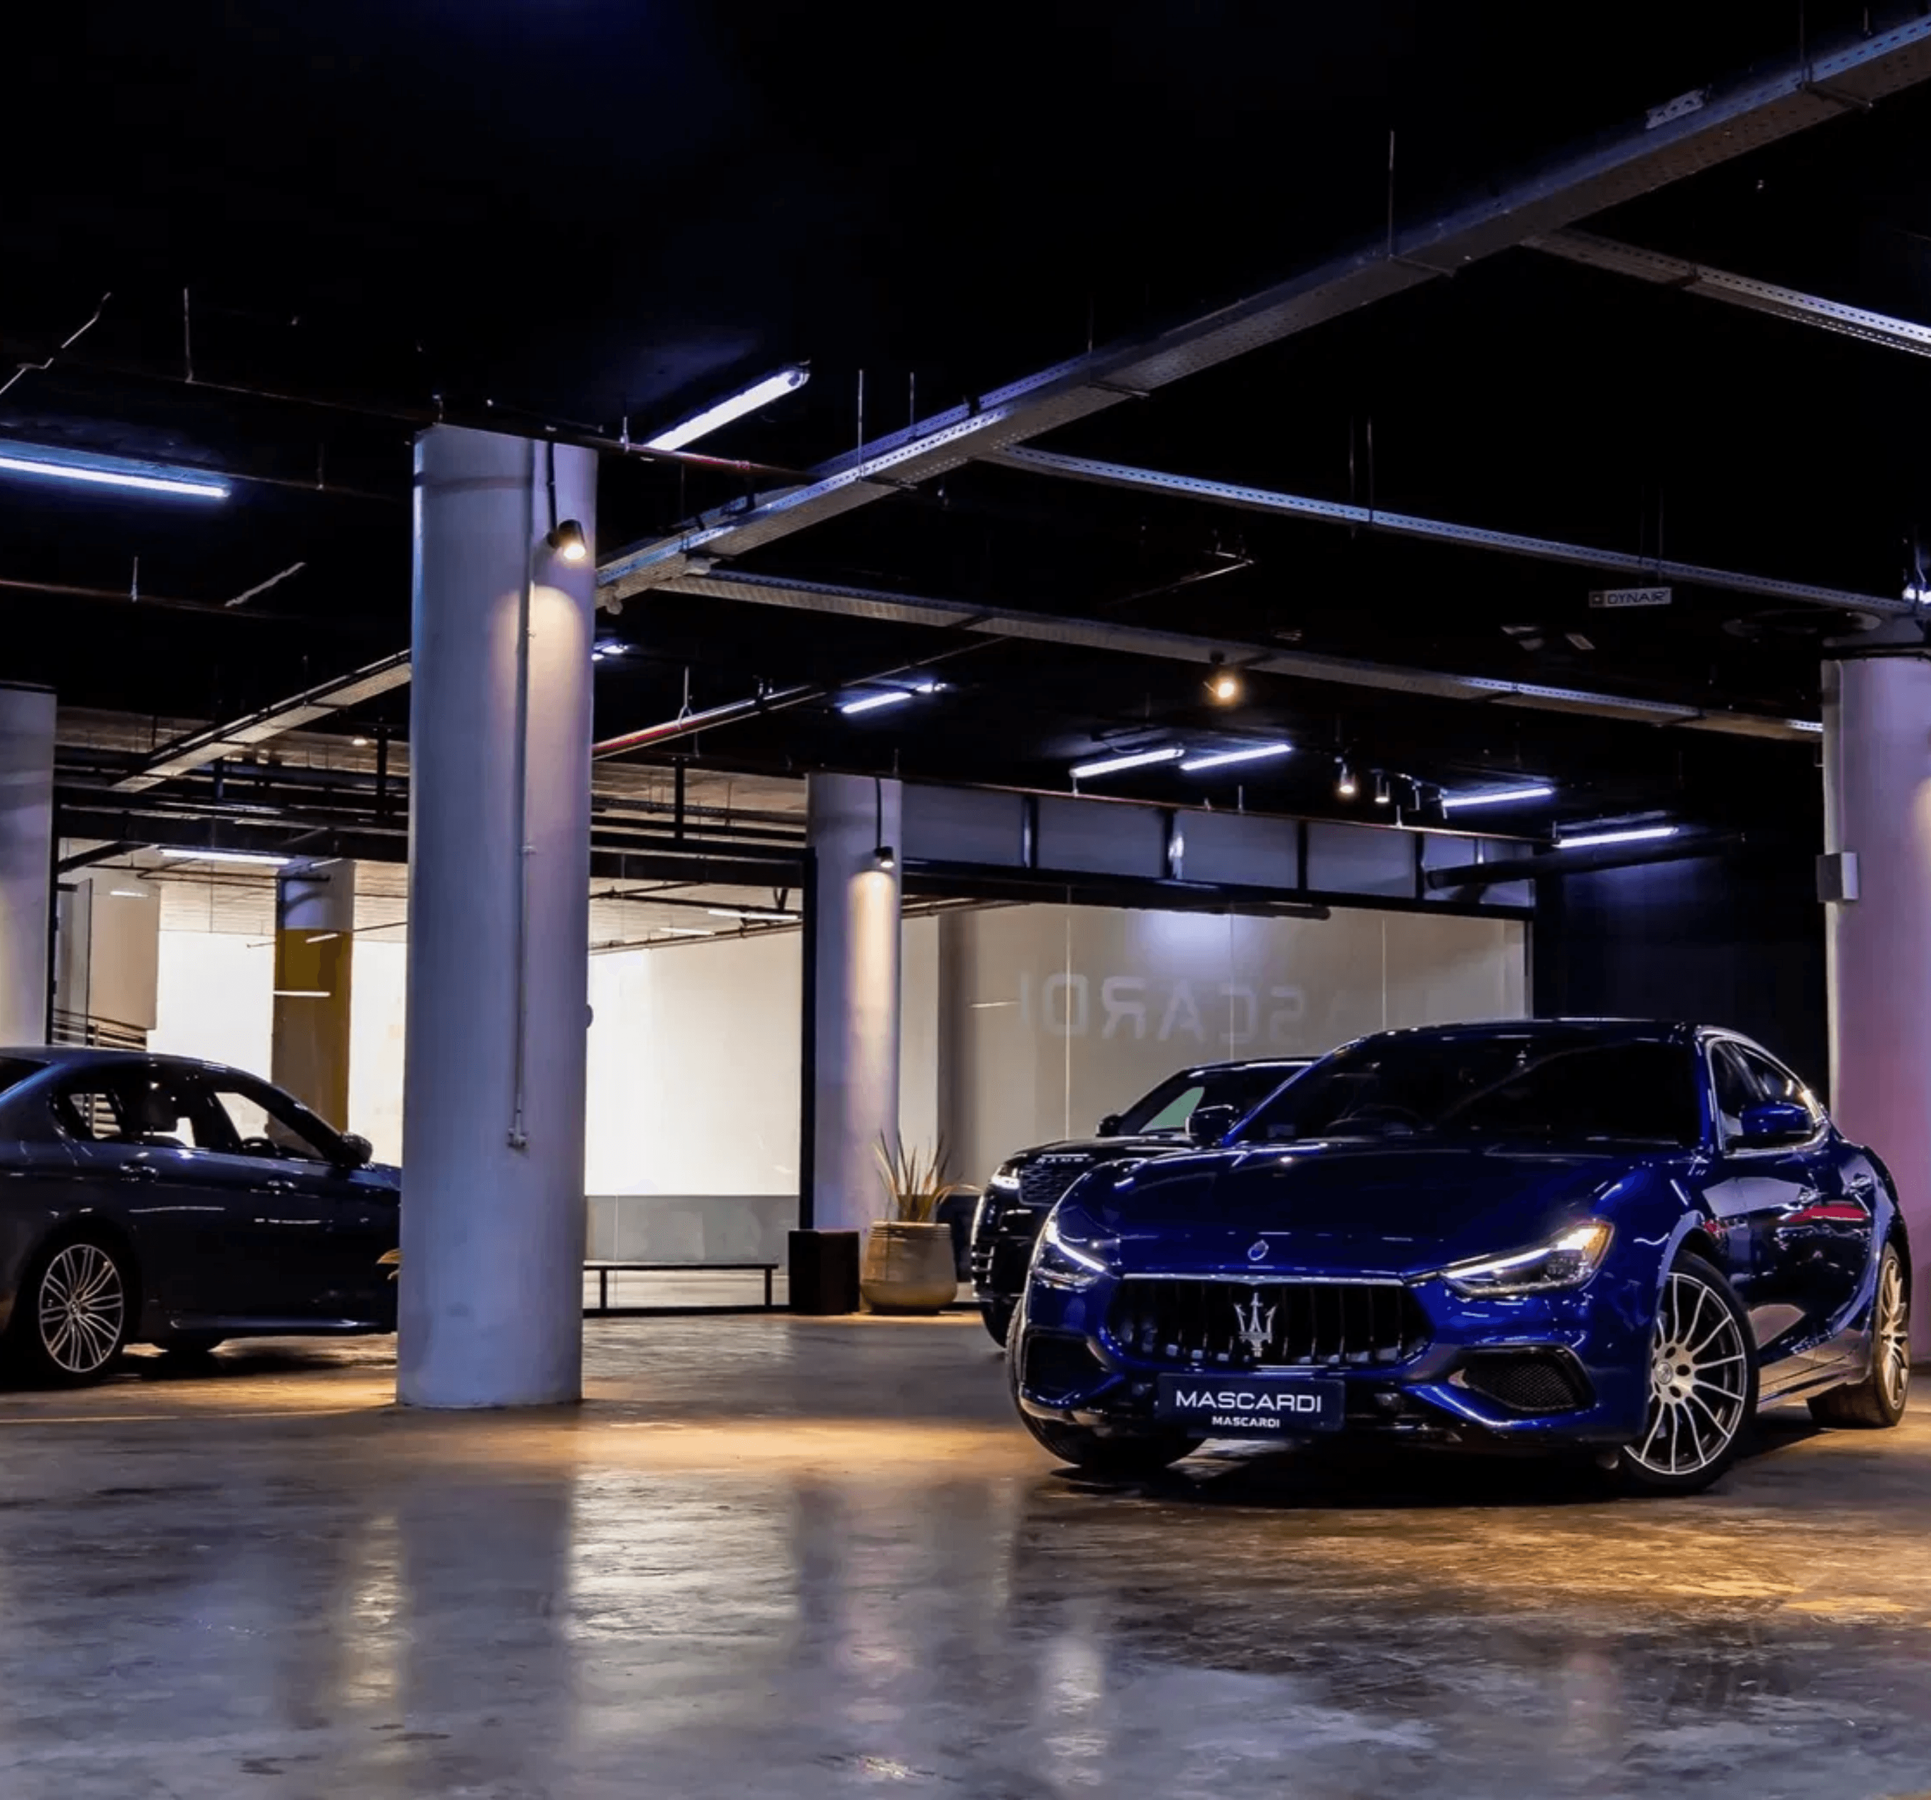
Prime Positioning in High-Traffic Upscale Districts
Target Locations
Strategic presence in Westlands and Lavington to capture premium foot traffic and brand visibility.
Financial Synergy
Deep ties with Nairobi’s banking and SACCO networks to deliver exclusive financing options for premium customers.
Operational Resilience
Leveraging Nairobi’s diversified economy to maintain stable demand beyond seasonal fluctuations.

Slide 6

Diversified Economic Drivers Ensure Long-Term Stability and ROI
01
02
03
Risk Diversification
Payback Potential
Market Resilience
Nairobi’s economy is insulated from seasonal tourism swings and port-specific logistics disruptions, providing a steady, year-round demand base.
Despite higher operational costs, the concentration of high-margin luxury transactions ensures a significantly faster return on investment compared to other regions.
A broad customer base—spanning corporate, diplomatic, and private sectors—provides a robust buffer against localized economic fluctuations.
"Nairobi offers the most resilient environment for premium automotive capital deployment in East Africa."

Slide 7
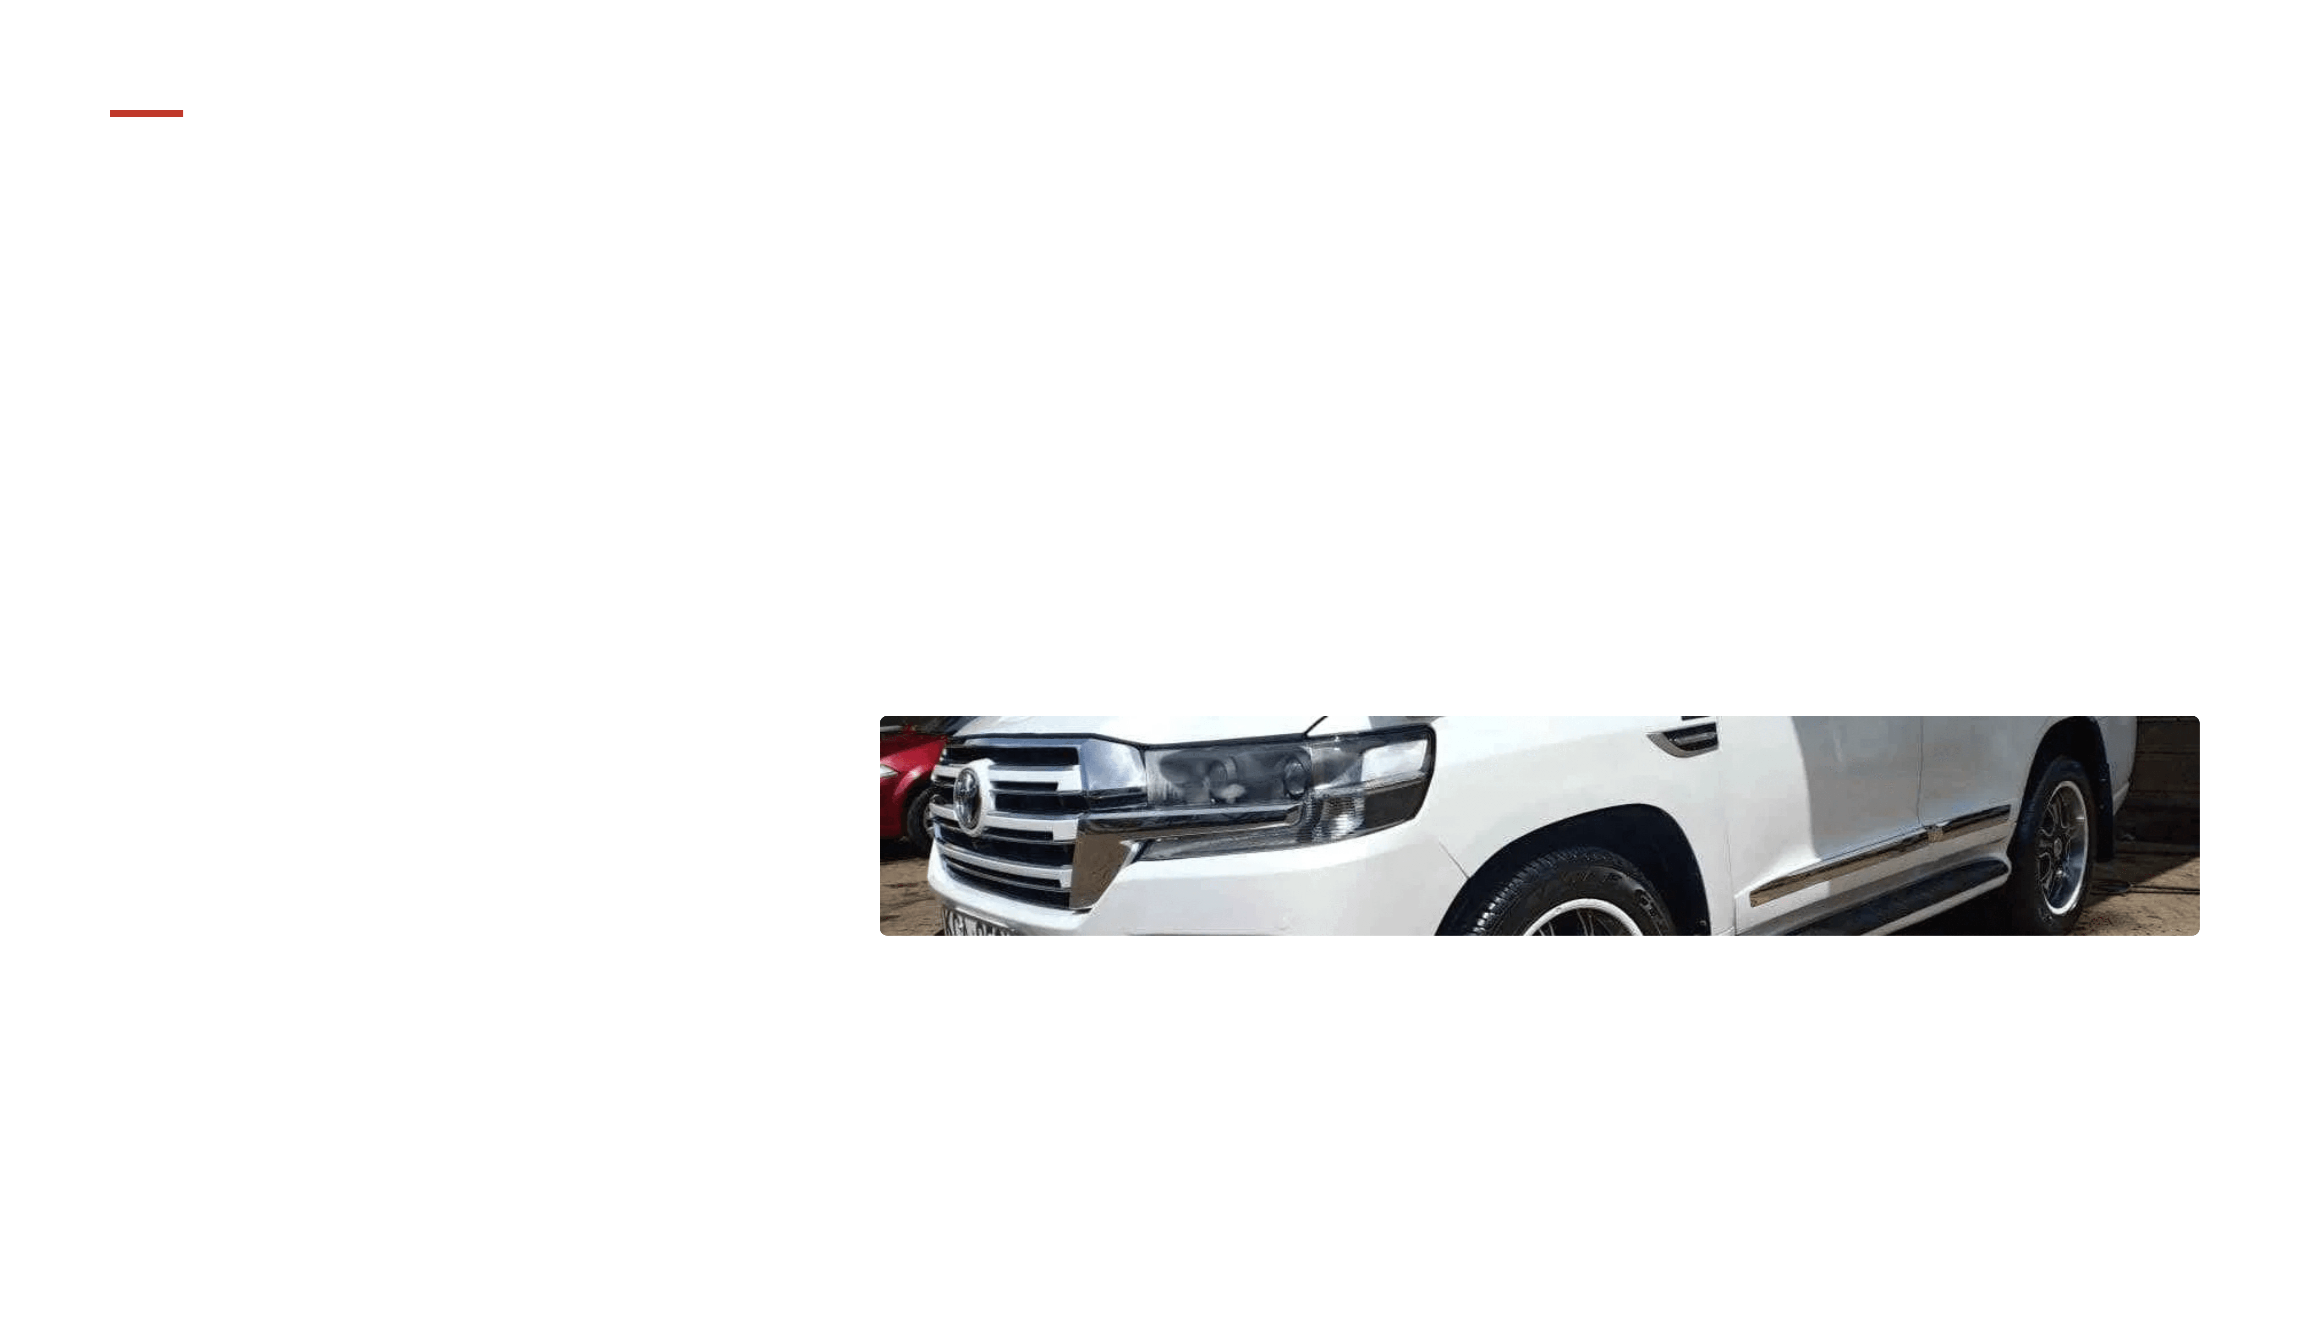
Strategic Execution Plan to Establish Market Leadership
Phase 01
Phase 02
Phase 03
Infrastructure
Synergy
Activation
Secure prime showroom location in Westlands or Lavington to capture high-income foot traffic and ensure maximum brand visibility.
Establish exclusive partnerships with local banks and SACCOs to provide seamless, premium financing solutions for our clientele.
Launch with a high-profile brand experience event targeting HNWIs, showcasing our commitment to automotive excellence.
The Vision
To become Nairobi’s preferred destination for premium automotive excellence and world-class customer experience.

